Slide 1
Render Portfolio for Populus Magos
a god game by Mario Battiston

Slide 2
TABLE OF CONTENTS
01
02
03
04
05
Brief Intro to Populus Magos
Each 3d Model rendered
Textures and Normal Maps
Camera (Isometric)
Scenes

Slide 3
01
Brief Intro to Populus Magos

Slide 4
Populus Magos
Story Intro
Game Summary
Populus Magos is a god game that takes inspiration from the great Populus 2 Trials of The Olympian Gods from developers Bullfrog Productions and publishers EA.
In the world of Populus Magos the Milky Way galaxy (our Galaxy) Stars are dying and the human colonies of the 21st Millenium are in peril of extinction. The Star Forgers is a Astra Faction that was formed in response the perils and they are tasked with traversing the exo-reaches for exo-planets that have been proven to have the resources necessary to reforge stars or forge new ones.
Magos is one such planet. And Magos is your mission. You are a Star Forge Astra Overseer of the Astra Formation 451 of the Star Forge Legion. Establish the Forgeworld, extract its Recources and Save our Stars!

Slide 5
02
Each 3d Model rendered

Slide 6
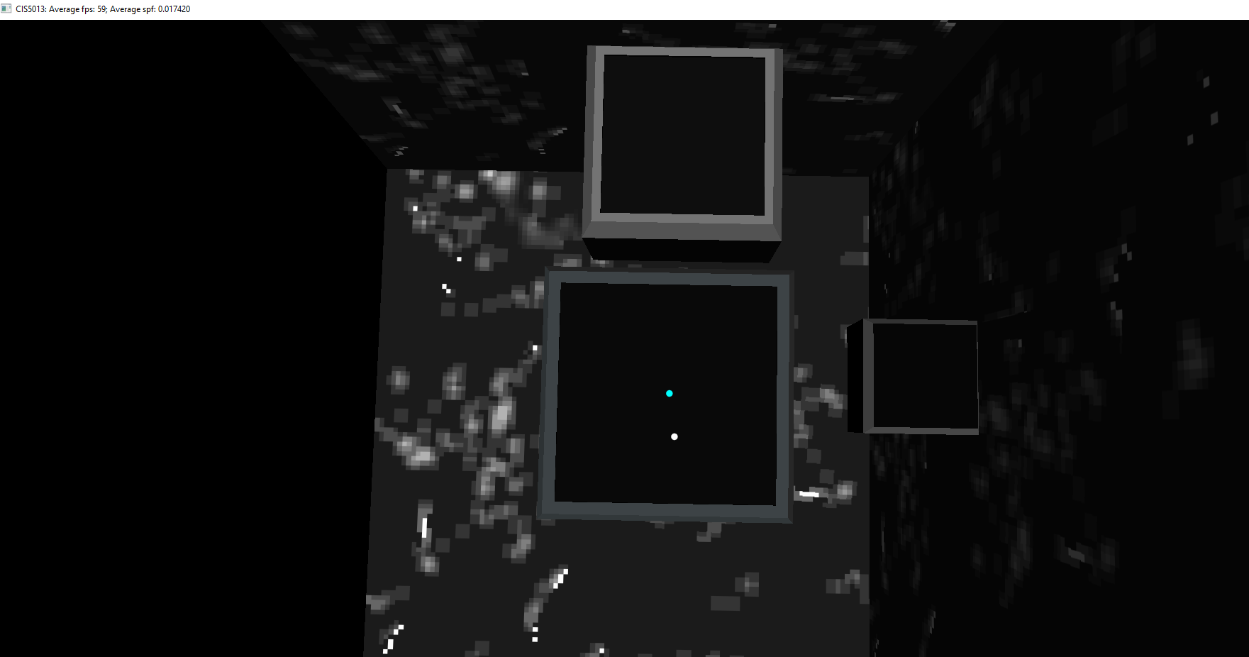
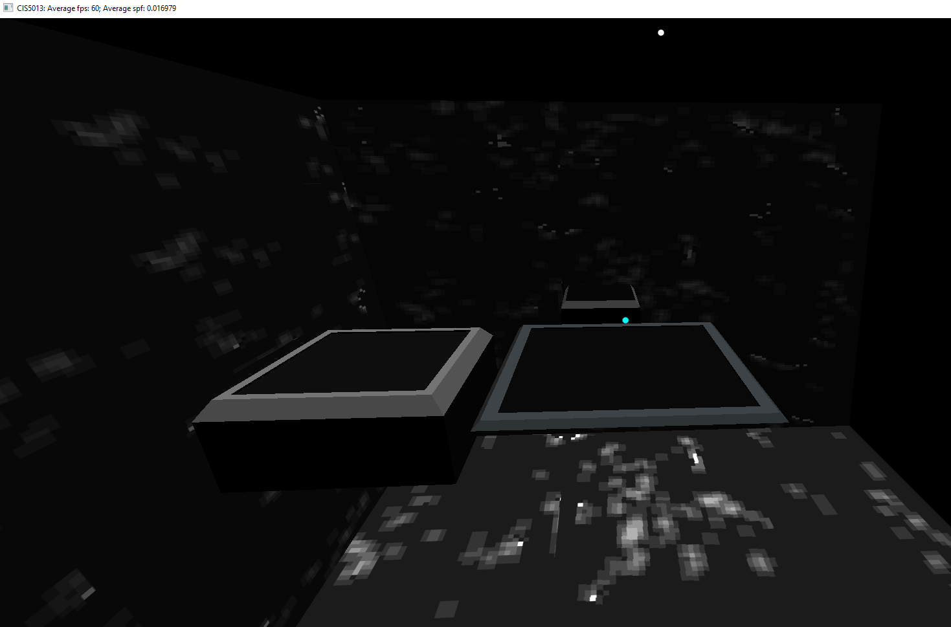
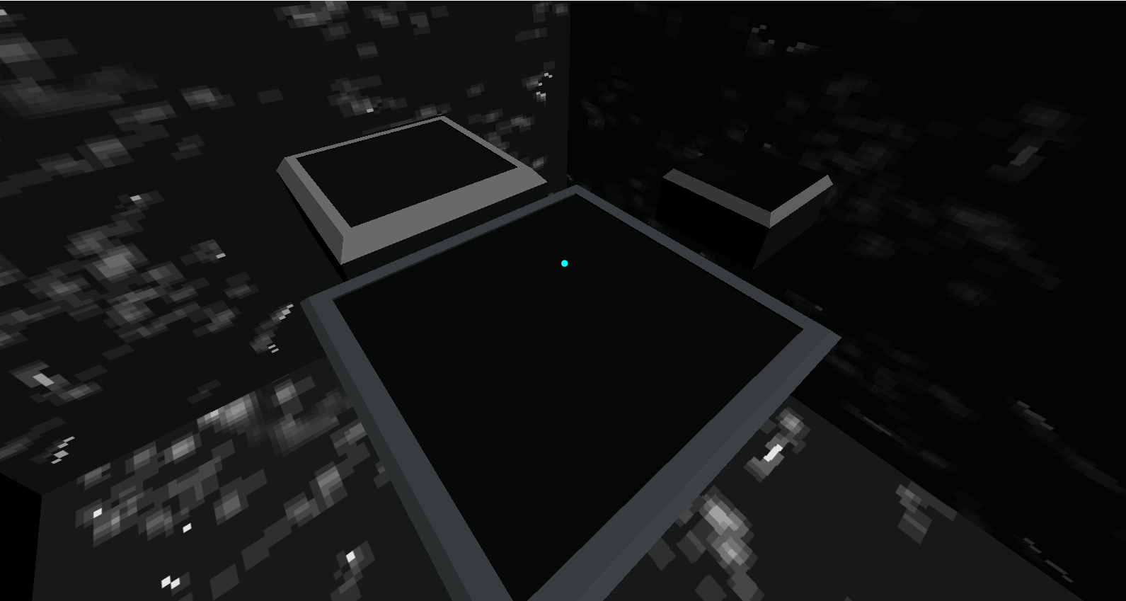
Terrain Board
Terrain Board
Main Ground plane where the game will play on
Map Board for the map and navigating where you are on the map.
Shrine board the board on which the shrine will be set upon. (This shrine will light different colors depending on if the player or enemy is winning acting as some visual communication)
Camera View

Slide 7
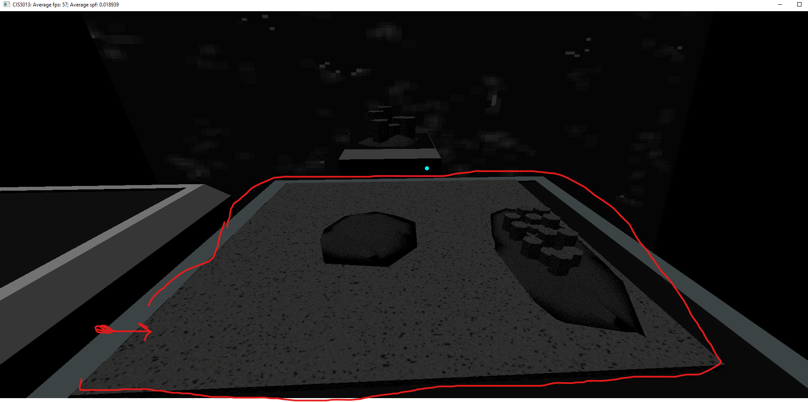
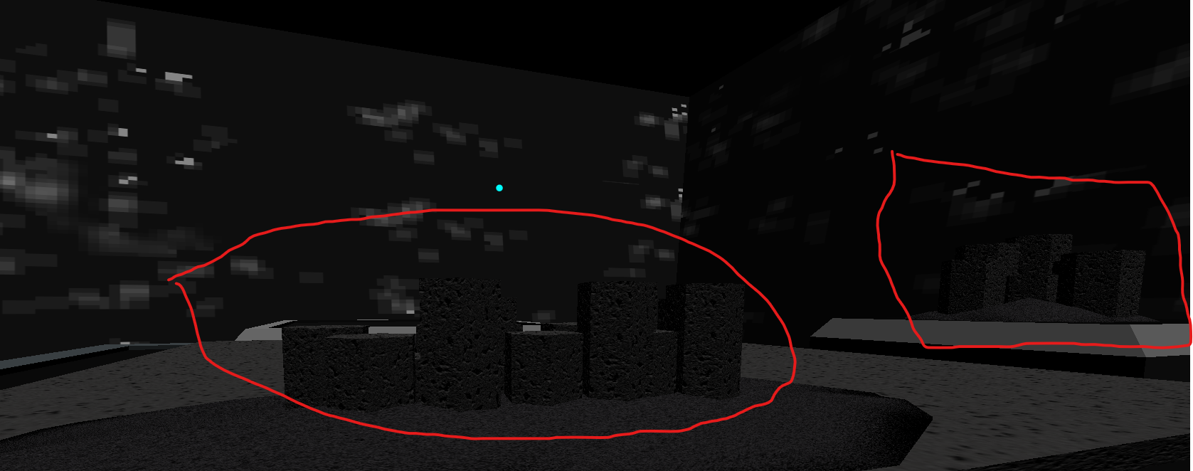
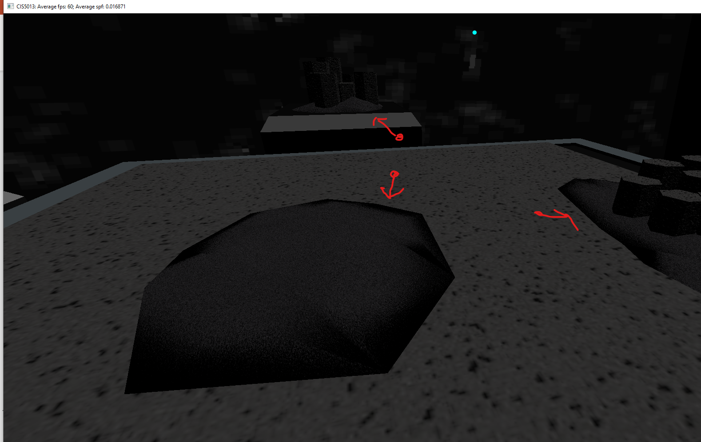
Ground Plane, Rock, Sand

Slide 8
03
Textures and Normal Maps

Slide 9
IN DEPTH ANALYSIS
UNVEILING COMPLEXITY
USEFUL RECOMMENDATIONS
Explore the heart of your subject with the in-depth analysis. Peel back layers, revealing the intricate details that matter. Whether it's a product feature or a social concern, this section is your space for careful examination. Provide readers with valuable insights, expert perspectives,
and data-driven clarity
Organize this section by starting with an introduction to set the context. Break down your main analysis into subsections. Encourage engagement through a call to action or discussion prompt, and offer additional resources for readers to explore further. Keep the content concise and maintain a clear flow

Slide 10
04
Camera (Isometric)

Slide 11
IN DEPTH ANALYSIS
UNVEILING COMPLEXITY
USEFUL RECOMMENDATIONS
Explore the heart of your subject with the in-depth analysis. Peel back layers, revealing the intricate details that matter. Whether it's a product feature or a social concern, this section is your space for careful examination. Provide readers with valuable insights, expert perspectives,
and data-driven clarity
Organize this section by starting with an introduction to set the context. Break down your main analysis into subsections. Encourage engagement through a call to action or discussion prompt, and offer additional resources for readers to explore further. Keep the content concise and maintain a clear flow

Slide 12
05
Scenes

Slide 13
IN DEPTH ANALYSIS
UNVEILING COMPLEXITY
USEFUL RECOMMENDATIONS
Explore the heart of your subject with the in-depth analysis. Peel back layers, revealing the intricate details that matter. Whether it's a product feature or a social concern, this section is your space for careful examination. Provide readers with valuable insights, expert perspectives,
and data-driven clarity
Organize this section by starting with an introduction to set the context. Break down your main analysis into subsections. Encourage engagement through a call to action or discussion prompt, and offer additional resources for readers to explore further. Keep the content concise and maintain a clear flow

